Slide 1
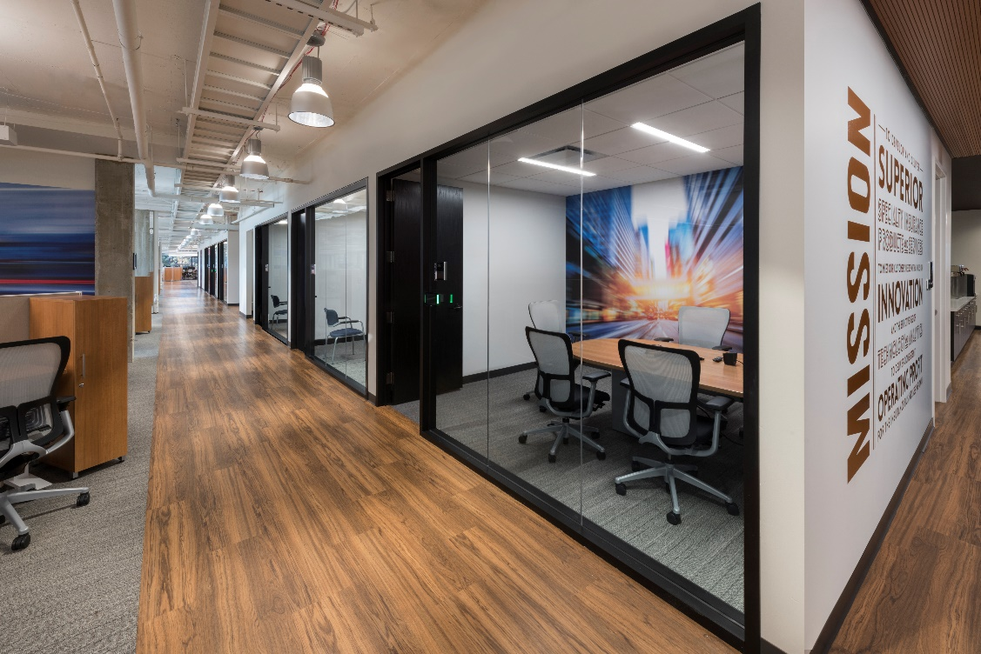
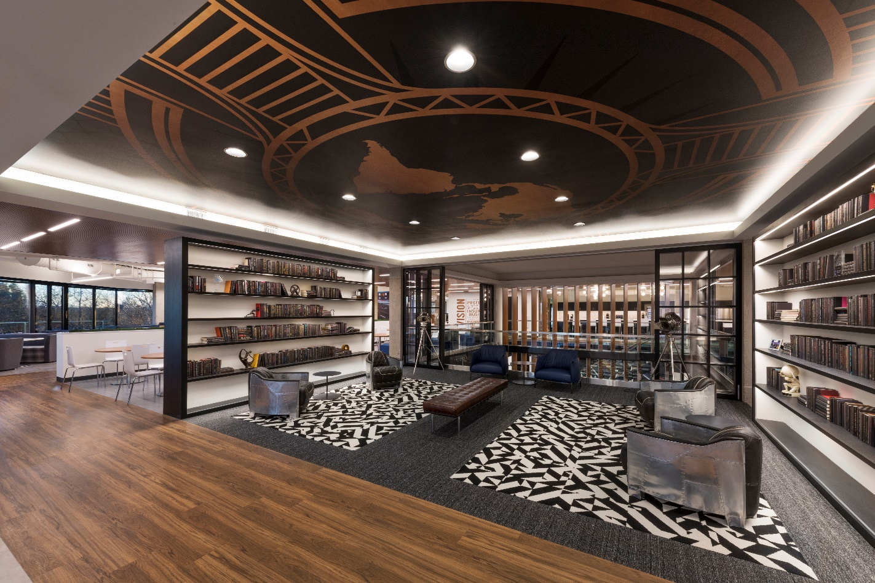
AAM Conference
Nasdaq: AFH
June 28, 2018

Slide 2
Safe Harbor: Atlas by the Numbers
Statements in this presentation, including the information set forth as to the future financial or operating performance of Atlas Financial Holdings, Inc., American Country Insurance Company, American Service Insurance Company, Gateway Insurance Company and/or Global Insurance Company of New York (collectively, “Atlas”), that are not current or historical factual statements may constitute “forward looking” information within the meaning of securities laws. Such forward looking statements involve known and unknown risks, uncertainties and other factors which may cause the actual results, performance or achievements of Atlas, or industry results, to be materially different from any future results, performance or achievements expressed or implied by such forward looking statements. When used in this presentation, such statements may include, among other terms, such words as “may,” “will,” “expect,” “believe,” “plan,” “anticipate,” “intend,” “estimate” and other similar terminology. These statements reflect current expectations, estimates and projections regarding future events and operating performance and speak only as to the date of this presentation. Readers should not place undue importance on forward looking statements and should not rely upon this information as of any other date. These forward looking statements involve a number of risks and uncertainties. Some of the factors facing Atlas that could cause actual results to differ materially from those expressed in or underlying such forward looking statements include: (i) market fluctuations, changes in interest rates or the need to generate liquidity; (ii) access to capital; (iii) recognition of future tax benefits on realized and unrealized investment losses; (iv) managing expansion effectively; (v) conditions affecting the industries in which we operate; (vi) competition from industry participants; (vii) attracting and retaining independent agents and brokers; (viii) comprehensive industry regulation; (ix) our holding company structure; (x) our ratings with A.M. Best; (xi) new claim and coverage issues; (xii) claims payments and related expenses; (xiii) reinsurance arrangements; (xiv) credit risk; (xv) our ability to retain key personnel; (xvi) our ability to replace or remove management or Directors; (xvii) future sales of common shares; (xviii) public company challenges; and (xix) failure to effectively execute our business plan. The foregoing list of factors is not exhaustive. See also “Risk Factors” listed in the Company’s most recent registration statement filed with the SEC. Many of these issues can affect Atlas’ actual results and could cause the actual results to differ materially from those expressed or implied in any forward looking statements made by, or on behalf of, Atlas. Readers are cautioned that forward looking statements are not guarantees of future performance, and should not place undue reliance on them. In formulating the forward looking statements contained in this presentation, it has been assumed that business and economic conditions affecting Atlas will continue substantially in the ordinary course. These assumptions, although considered reasonable at the time of preparation, may prove to be incorrect.
When discussing our business operations, we may use certain terms of art which are not defined under U.S. GAAP. In the event of any unintentional difference between presentation materials and our GAAP results, investors should rely on the financial information in our public filings.
Corporate Headquarters | Schaumburg, IL (Chicago Suburb)
Core Target Markets | Taxi/Limo/Livery/Paratransit
NASDAQ: AFH | At 3/31/2018 | At 12/31/2017
Cash and Investments | $239.3 million | $243.5 million
Total Assets | $507.5 million | $482.5 million
Total Atlas Shareholders’ Equity | $91.4 million | $90.6 million
Common Shares Outstanding (includes Restricted Share Units) | 11,944,378 | 12,178,857
Book Value Per Common Share Outstanding | $7.62 | $7.42

Slide 3
The Evolution of Atlas’ Business Model
Strategic Goal
LEVERAGE STRONG VALUE PROPOSITION
& LEADING EDGE FINTECH
Across market cycles, our objective is to exceed industry ROE by at least
500 to 1,000 bps
Amplify value drivers by combining specialty insurance infrastructure, analytics and innovative technology
Differentiation in core niche as well as horizontal expansion opportunities
Initial Formation
(Four Insurance Company Subs)
Utilize decades of data as a tangible advantage
Established best practices and compiled centralized repository
Leveraged newly developed operating system
Integrate Advancements in Technology to Specifically Apply to Atlas’ Niche Market
Positively impact pricing, risk selection, fraud detection and claim efficacy
Telematics, Machine Learning, Predictive Analytics
Established relationships with key technology partners
Create First Mover Advantage in
Changing Light Commercial Auto Market
Development and Implementation of innovative programs
Usage Based (“UBI”) approach to micro duration underwriting
Digital marketing and customer engagement

Slide 4
Premiums at Insurance Subsidiaries
(Including historic premium at ACIC & ASI)
2018 Gross Written Premium Expected to Exceed $300 Million
Acquired 2010
American Country and American Service
Insurance Cos.
(as part of going-public transaction)
Acquired 2013
Gateway
Insurance Co.
Acquired 2015
Global Liberty
Insurance Co. of NY
Atlas Strategic Plan to Recapture and Continue to Grow
Proportionate Market Share in niche is > $400 mil

Slide 5
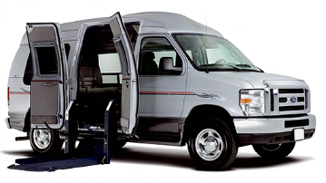
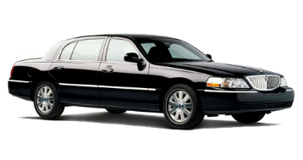
Atlas’ Niche Target Market
“Light” Commercial Automobile Sector
Includes:
Taxis operating in in local metropolitan and rural areas
Prearranged transportation such as luxury vehicles, limousine, vans, and minibuses
Professional transportation network company (“TNC”) drivers
Social service and non-emergency para-transit in local areas
Commercially licensed drivers
Owner-operated and small operation fleets (1-10 vehicles)
Generally, insured to minimum required policy limits
People Who Transport People

Slide 6
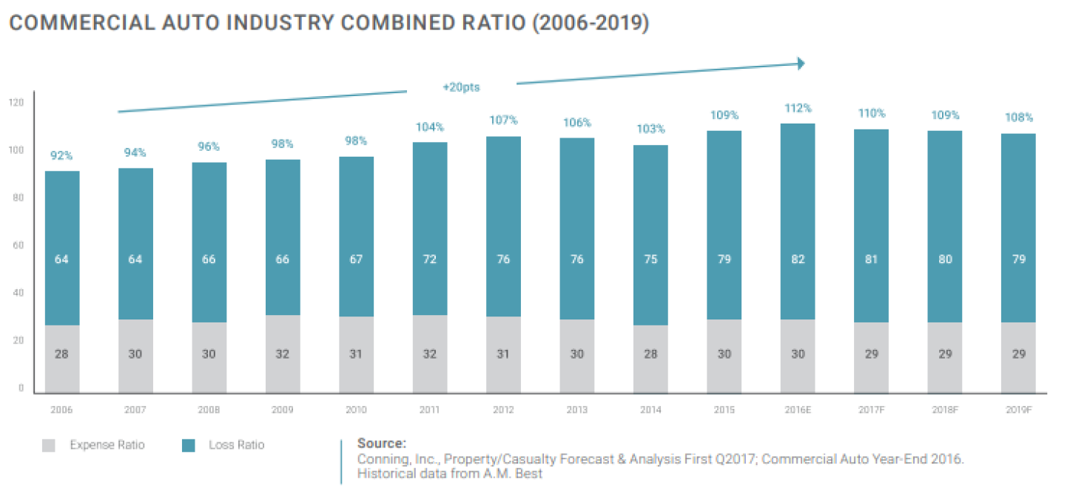
Market Conditions

Slide 7
Analytics & Technology
in Underwriting

Slide 8
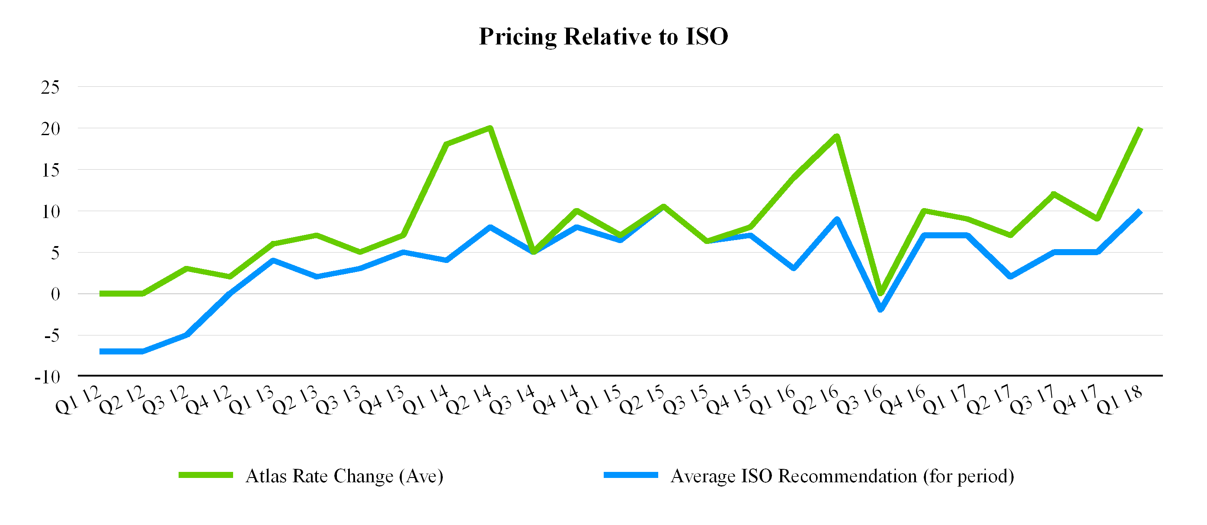
Rate Environment
Consistent sequential increase in base rates ahead of industry

Slide 9
Predictive Modelling: Underwriting Related Objectives
Loss ratio
Earned exposures
Training data
Validation data
Less of These
More of These
Score Group
Notes:
NTD: Discuss expected results from U/W model, but don’t go too far into weeds

Slide 10
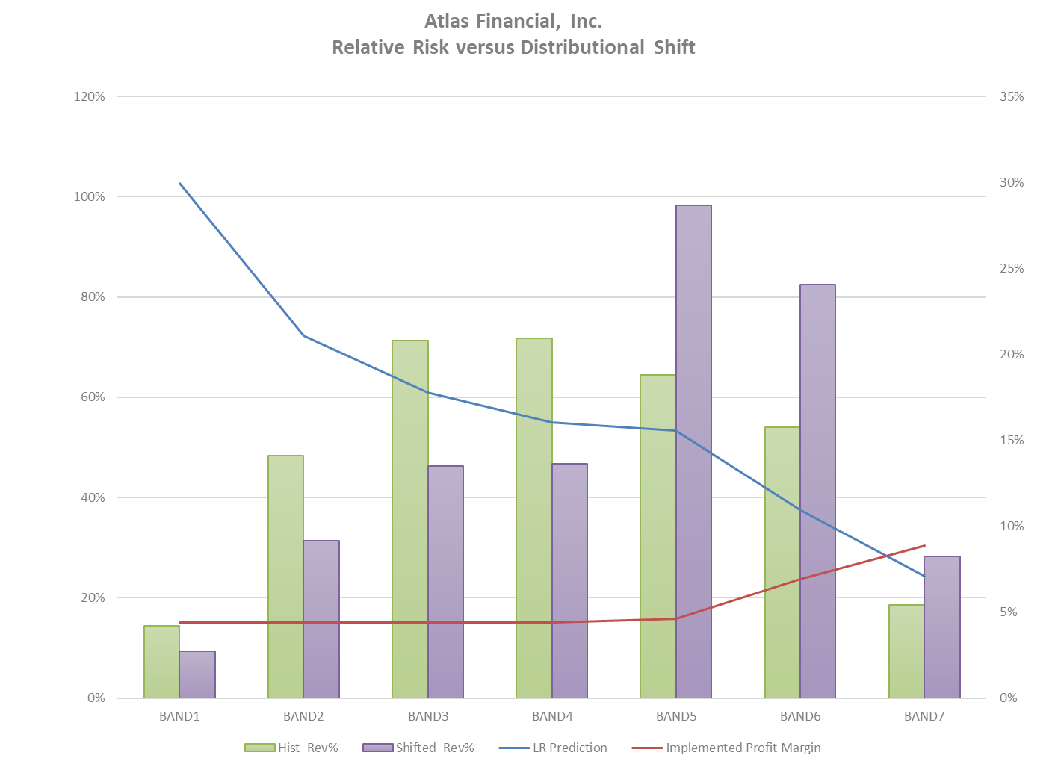
Predictive Modelling: Underwriting Related Objectives
Shift toward more profitable accounts
Expanded margins

Slide 11
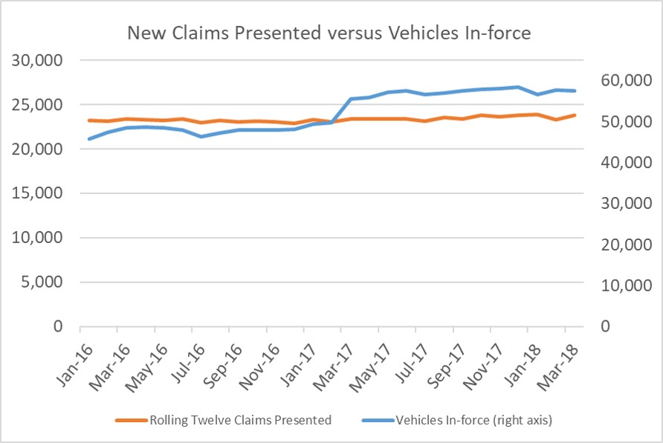
Improved Risk Selection
Reported claims per insured vehicle down approximately 20%

Slide 12
In Vehicle Technologies
Cameras
Increasingly sophisticated
Accident avoidance Systems
OEM
Aftermarket
Mobileye
Passive
Active
GPS
Dongles
Mobile Phone Apps
Ongoing review beginning in 2011 when Atlas was formed.
Conclusions:
No single “best” solution
Significant difference between various approaches
Atlas Approach:
Identify optimal solution for specific circumstances/objectives
Committed Partnerships

Slide 13
Atlas/Nauto Camera Pilot
November 2017 test began utilizing 1,000 cameras
Inward and outward facing
Artificial Intelligence and Facial recognition
Cellular uplink
Currently at approximately 2,000 and growing
Test results to date
Aggressive drivers are involved in 10% more accidents than non-aggressive drivers
Impact of telematics alone is helpful, but limited
Distracted drivers are 2.4 times more likely to be involved in an accident
This is true for both aggressive and non-aggressive drivers
Goal is to counsel drivers on better behavior, not just fire them
In addition some Accounts are utilizing both Incentives
Gas Cards
Free lunch
And Deterrents
Fines
Suspensions

Slide 14
Atlas/Nauto Camera Pilot
In addition to reducing frequency of accidents, severe incidents where drivers fail to slow or stop are expected to be positively impacted as well
Significant reduction in distraction events based on identification, active feedback between Atlas and policyholder and driver training

Slide 15
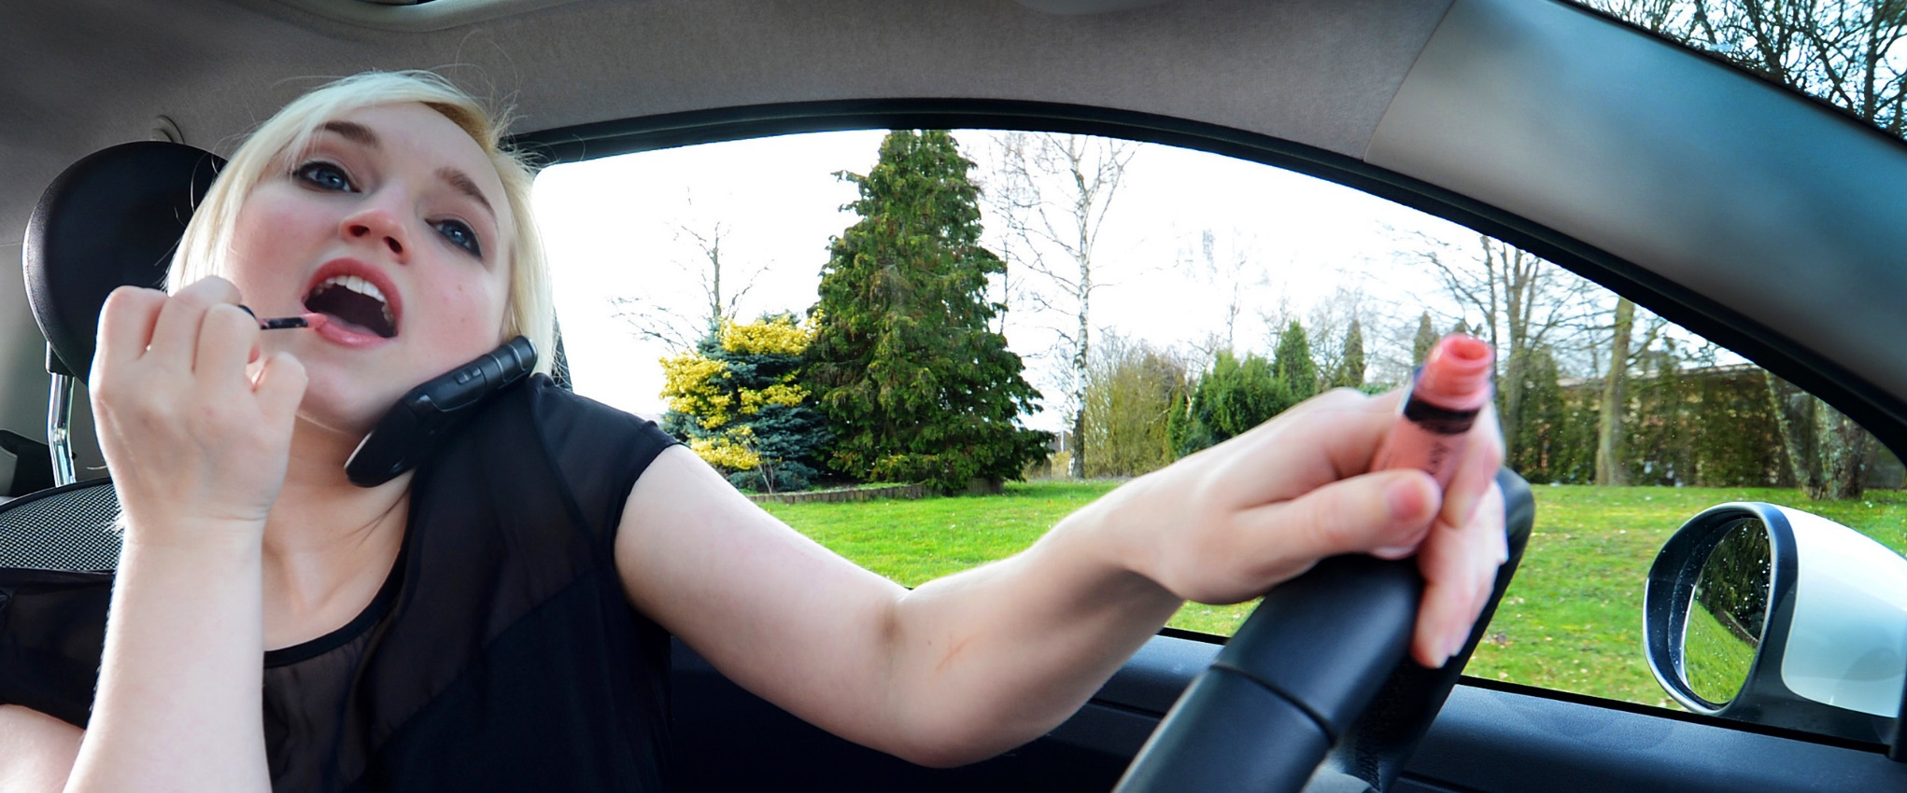
Distracted Driving Examples
While phone use is often a cause of distraction, video evidence confirms numerous other significant risk factors

Slide 16
“Curb Appeal”

Slide 17
“Hollywood Drive”
Watching a movie!
No seat belt

Slide 18
“Hydrate”

Slide 19
“Multi Tasking”

Slide 20
Results to date
Loss frequency for test accounts has decreased 30%
Early observations support severity impact
Utilized as a tool to make otherwise unacceptable accounts acceptable
Example: 62 unit Paratransit account that was otherwise unacceptable due to a high claim frequency
It is loss free for the last 7 months
Technology partners have agreed to discounted pricing for Atlas customers
In the last couple weeks an additional 500 devices have been installed by Atlas customers in connection with our initiatives

Slide 21
Analytics & Technology
in Claims

Slide 22
Predictive Modeling: Claim Related Objectives
Target claims between $10k and $50k
Majority of claims are <$10k and settle for approx. $1,000
Small percentage are >$50k and tend to have signs of severity early
16% of closed scored claims are between $10k - $50 and represent 45.3% of settlement dollars for the cohort of scored claims
Goals
Intended Impacts
Better predict ultimate severity
Target potentially larger claims earlier
Enhance triage and routing of claims
Earlier settlement for meritorious claims
Amplify resource allocation
Adjuster experience and more effective defense, when appropriate
Increase expected return on internal resource and ALAE deployment
Achieve better overall results for policyholders and company

Slide 23
Tools of Our Trade
Amplifies Internal Expertise
Specific tools for range of challenges/issues
Hard to Replicate

Slide 24
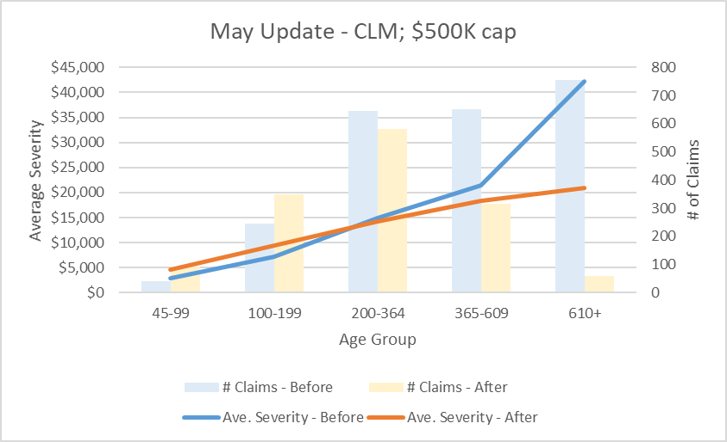
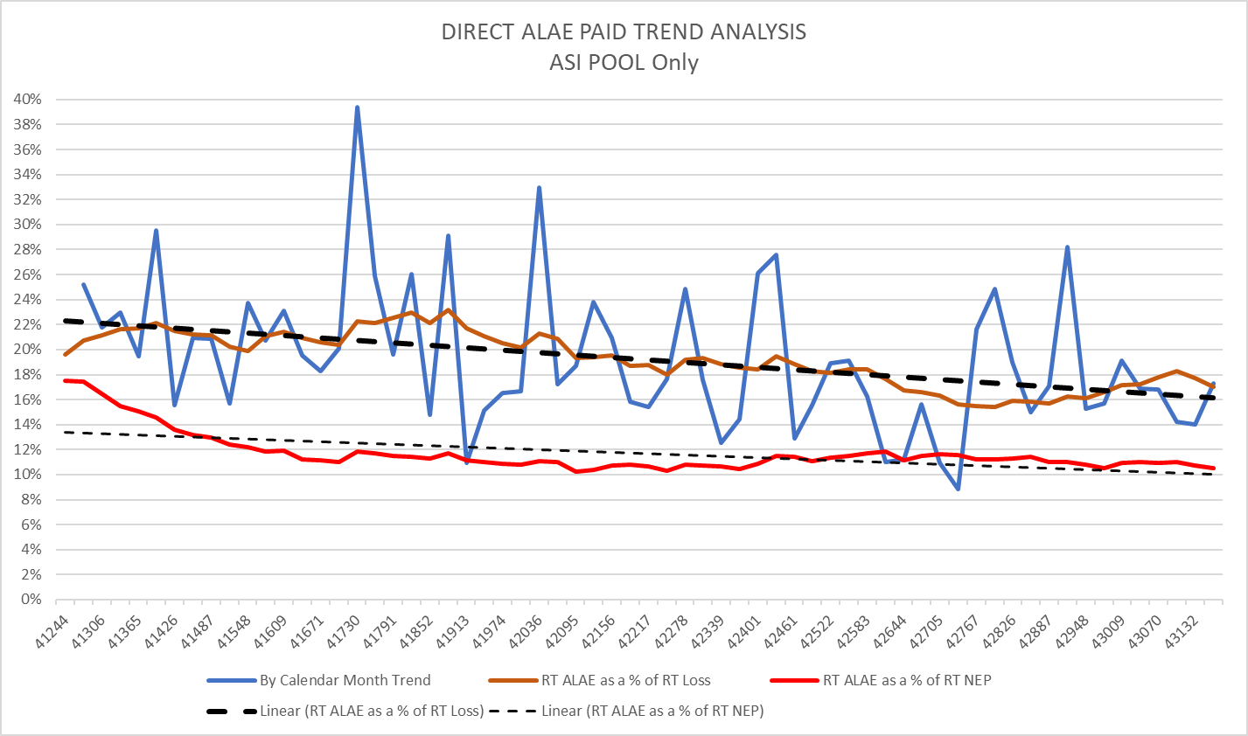
Impact on Claim Severity
Positive Impact on Claim Payments
Better ROI on Loss Adjustment Expense
Source: Guidewire Predictive Analytics / Atlas data

Slide 25
Video Example
Impact on Subrogation

Slide 26
Changing Behavior to Drive Outcomes
Outcome improved by…
Our insured’s vehicle was a total loss
We paid out $40K
A subrogation claim was made against GEICO
GEICO denied liability advising their insured claimed to have been stopped in left turn lane when rear-ended
After sending the video to GEICO we were successful in collecting back our indemnity dollars

Slide 27
Video Example
Impact on Defense

Slide 28
Changing Behavior to Drive Outcomes
Outcome improved by…
At the scene of this accident the claimant driver told the police that we ran the red light
Our driver correctly stated that he had the right of way
We sent the claimant’s attorney a copy of the video and have denied liability
Absent the video this would be a word vs. word situation resulting in a compromised indemnity settlement with ALAE as well

Slide 29
Video Example
Impact on Causality

Slide 30
Changing Behavior to Drive Outcomes
Outcome improved by…
Nevada claim where our driver pulling into stopped traffic attempting to enter a left turn lane
Claimant vehicle sideswiped the front of our vehicle in a glancing blow
The pregnant passenger claimed she hit her head and had complications with her pregnancy
We controverted based on causation
Suit was filed and the plaintiff never waivered from their policy demand
At mediation the mediator agreed that the video completely contradicted plaintiff but still awarded her $13K in medical given she was 10 weeks pregnant
We rejected the award and a date was set for trial
Ultimately the case was dismissed for non-compliance by the plaintiff and we paid no indemnity and only nominal ALAE

Slide 31
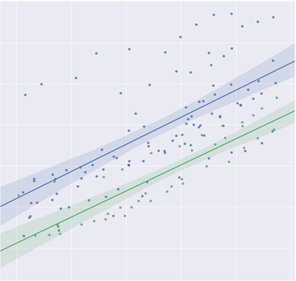
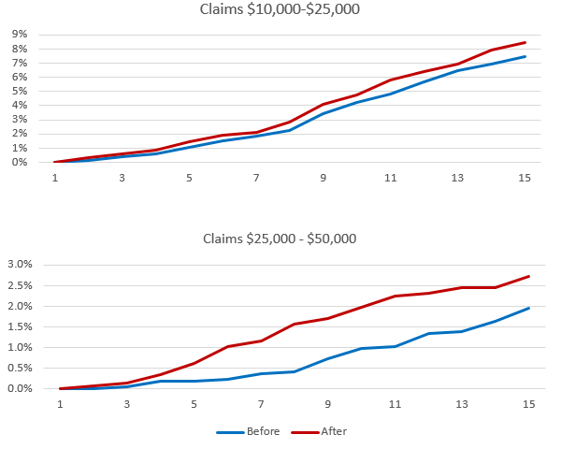
Claim Ecosystem
Earlier settlement of legitimate claims and more effective defense, where appropriate
Focus resources on small % of claims that represent significant dollars paid
10% - 20% Reduction in Severity

Slide 32
Future Vision for
Commercial Auto Insurance

Slide 33
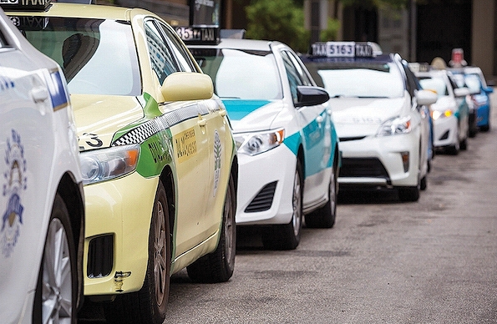
Addressable Market: Niche Market Trajectory
Near Term
Market
Environment
Specialized Use, Alternative to Car Ownership
Product
Evolution
Continued Variety, Newer Vehicles
More Differentiated Driver Behavior

Slide 34
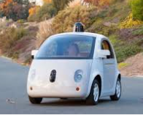
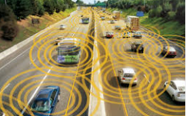
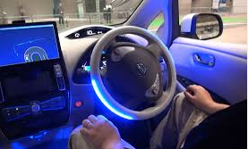
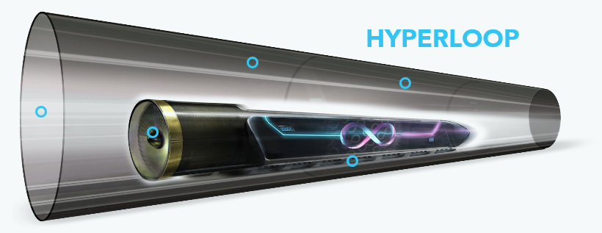
Addressable Market: Niche Market Trajectory
Future
Market
Environment
Product
Evolution
Driver Assist, Autonomous Vehicles
Technology Impact on Lifestyle, Passenger Needs
Connected Cars, Internet of Things

Slide 35
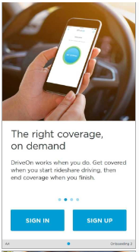
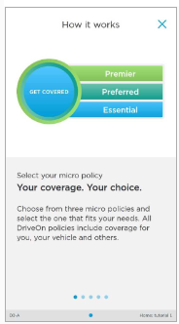
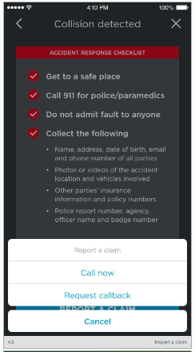
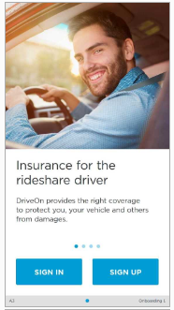
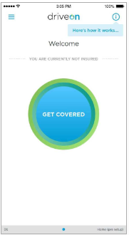
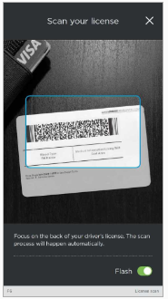
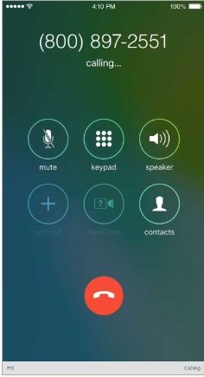
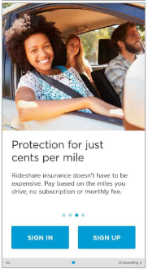
Usage Based Insurance
https://www.getdriveon.com/

Slide 36
Elements Critical to Success
Strategy
People
Technology
Partners
Vision
Mission
Values
Experience
Expertise
Ability
Internal
Analytics
External
Distribution
Customers
Product

Slide 37
Conclusion
Business Risk is Changing
Customer base
Industry
Fungible capital (e.g. reinsurance, alternatives, etc.)
Fintech vs. Traditional Insurance
Impact on Capital Allocation
Potential duration compression
Opportunity versus cost of capital
Other Considerations
Stakeholder perspective (e.g. investors, private owners, etc.)
Skill sets relative to VC exposure (e.g. Fintech, In-Vehicle Tech, Autonomous, etc.)
Need to Innovate is Ongoing
37

Slide 38
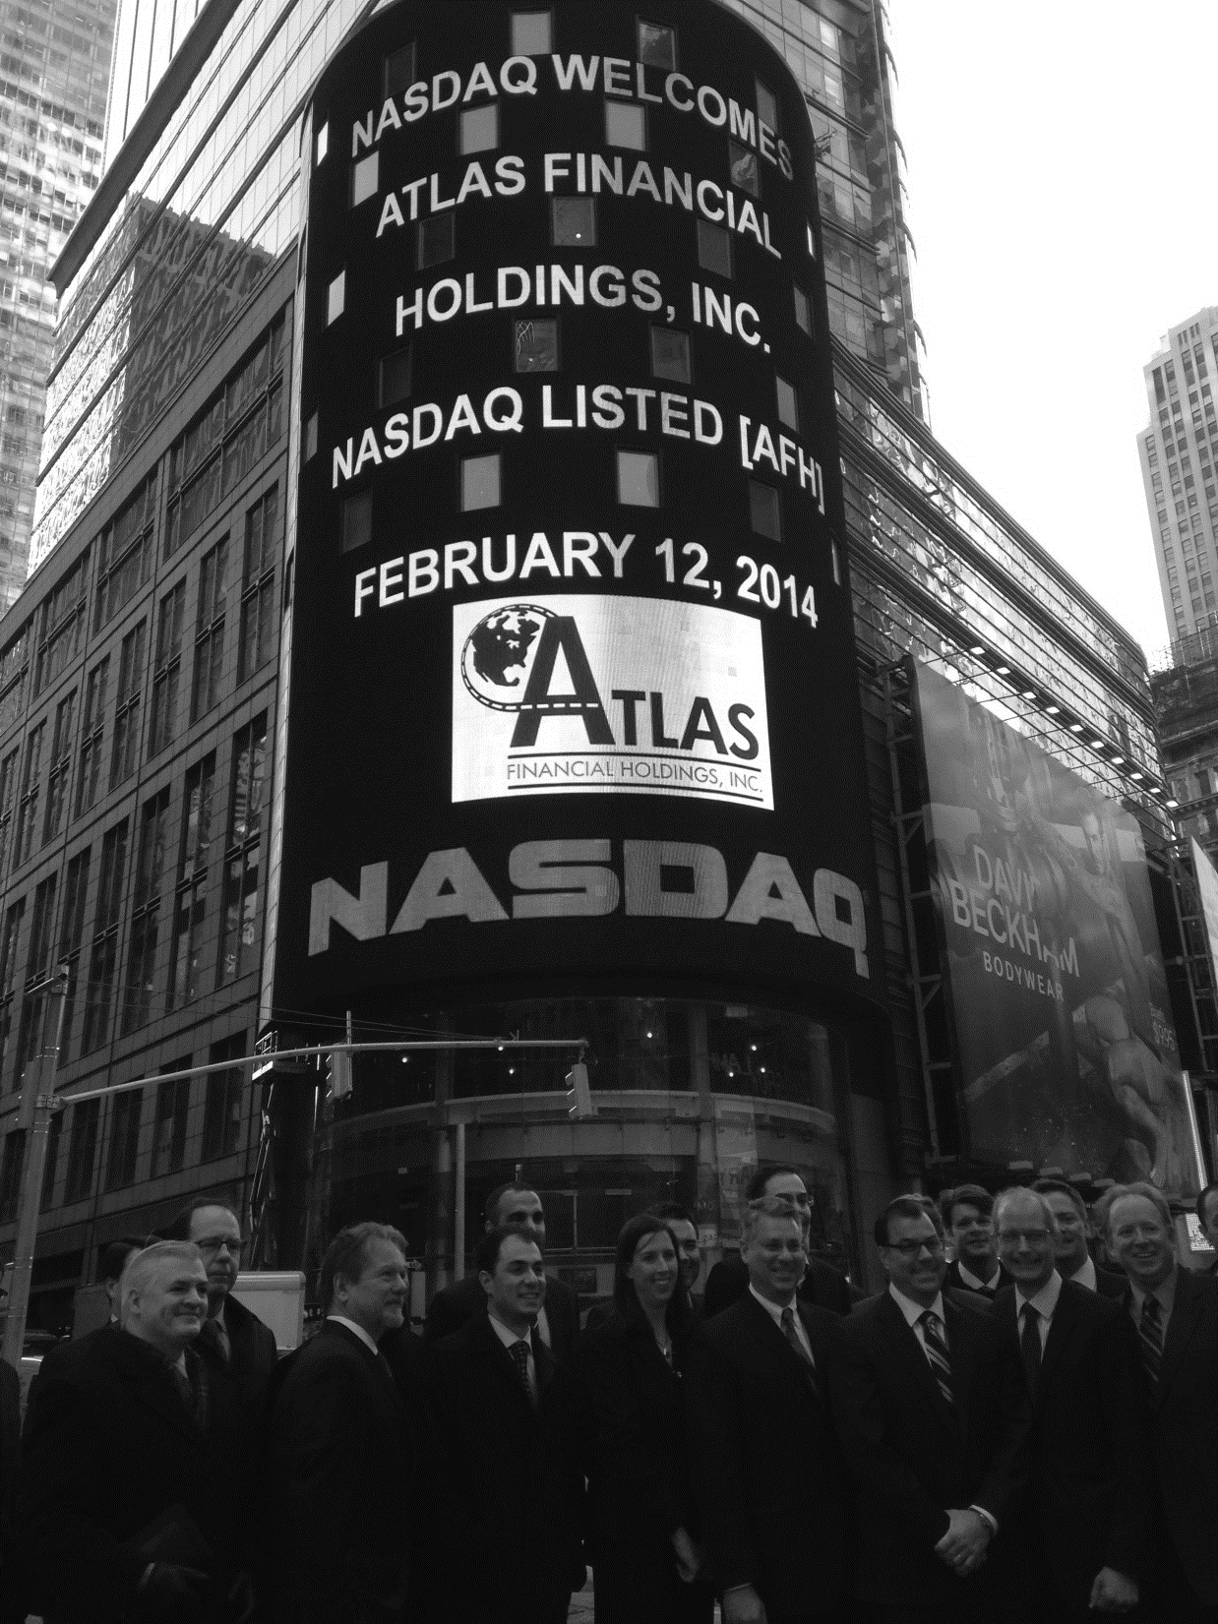
Contact Information
Nasdaq: AFH
For Additional Information
At the Company: | Investor Relations: The Equity Group Inc.
Scott Wollney Chief Executive Officer swollney@atlas-fin.com 847-700-8600 | Adam Prior Senior Vice President APrior@equityny.com 212-836-9606

